Slide 1

Credit Limit Automation
Driving ROI and Frictionless Onboarding via Machine Learning
STRATEGIC EXECUTIVE BRIEFING

Slide 2

Automated Credit Limit Engine
The Business Challenge
Identifying Inefficiencies in Legacy Underwriting
Executive Interpretation: The model establishes a foundational starting credit limit of $1,945.20$ (the Y-intercept) and applies a risk-calibrated 1.51x multiplier (the slope) for every dollar the applicant earns.

Slide 3

The Problem
The Solution
We are introducing an automated, real-time Credit Limit Allocation Engine embedded directly into our digital loan origination platform.
Instant Decisioning: Slashes application processing times from 2 days to under 1 second (200ms), removing onboarding friction and capturing high-intent customers instantly.
Resource Optimization: Automates 70% of the standard application queue, allowing human underwriters to shift focus exclusively to complex, high-net-worth portfolios.
Financial Impact: Projected to generate $2.05M in net business value and savings in Year 1 alone (585% ROI) through a combination of recovered revenue, labor savings, and minimized credit defaults.
Strict Guardrails: The system is protected by automated risk boundaries, including an automation ceiling cap $18,000),aminimumfloor\left(\$2,000\right),andanautomatic$
$routing trigger to humanunder writers for high−incomeoutliers(\$>25,000\text{/}\text{month}$).
Our current retail credit card underwriting process is bottlenecked by manual workflows, creating critical operational and revenue liabilities:
High Customer Churn: Manual reviews take 24 to 48 hours, resulting in an 18% abandonment rate from digital applicants who abandon the pipeline for instant-approval competitors.
Inflated Operational Costs: Underwriters spend over 60% of their time manually auditing low-risk, highly predictable applications, costing the bank an estimated $450,000 annually in unnecessary labor overhead.
Inconsistent Risk Exposure: Human underwriting introduces subjective bias, causing erratic credit line allocations that either under-monetize affluent applicants or over-leverage high-risk profiles.
The Algorithm & Model
To ensure complete transparency, regulatory auditability, and speed, the engine is powered by a Simple Linear Regression model.
How it works: The algorithm analyzes historical data from active, good-standing customers to isolate the exact relationship between an applicant's verified monthly income ($X$) and their optimal, safe credit limit ($Y$). It charts a mathematical "Line of Best Fit" that cuts cleanly through data variances to establish an objective, standardized rule.
The Production Formula:$$\text{Approved Credit Limit} = 1.51 \times (\text{Monthly Income}) + \$1,945.20$$

Slide 4






Legacy Friction & Operational Cost
High Latency
18% Abandonment
$450k Excess Cost
Manual underwriting takes 24-48 hours, creating a massive bottleneck in customer acquisition.
Applicants leave the pipeline due to wait times, benefiting faster digital competitors.
Operational overhead from manual auditing of low-risk, standard applications.

Slide 5



The Linear Regression Solution
The Mathematics
Business Interpretation
Y (Intercept): $1,945 baseline limit for qualified entry-tier earners.
Slope (m): 1.51x multiplier. For every $1,000 in monthly income, the limit increases by $1,510.
Translating income data directly into revenue-optimized credit limits with absolute transparency.

Slide 6

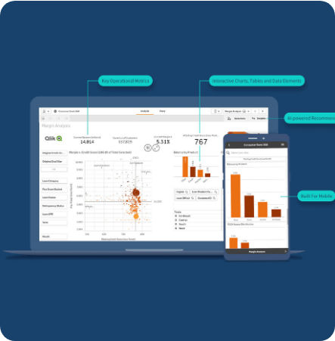

Model Accuracy & Predictive Power
98%
$782
R-SQUARED SCORE
RMSE VARIANCE
Accuracy & Compliance:
Backtesting against active accounts yielded an $R^{2}$score of 98%, meaning the formula almost perfectly mirrors safe historical lending parameters. Because the model uses simple linear math rather than an unexplainable "black box" algorithm, it is 100% compliant with fair lending regulations and model risk governance standards.
Validated against 1,000 historical rows with near-perfect correlation between income and approved safety limits.

Slide 7
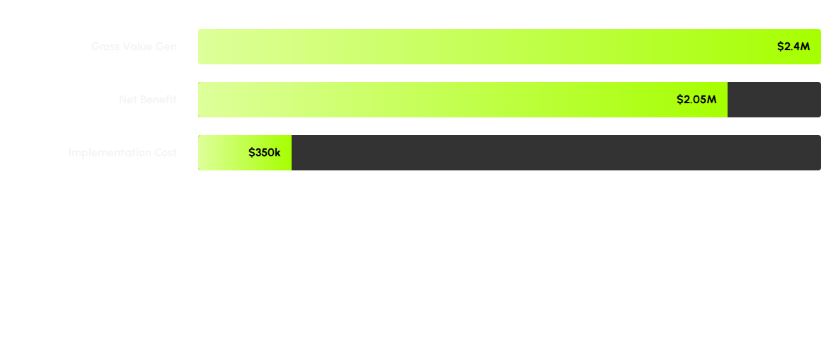
Projected First-Year ROI
585%
FIRST YEAR RETURN ON INVESTMENT

Slide 8

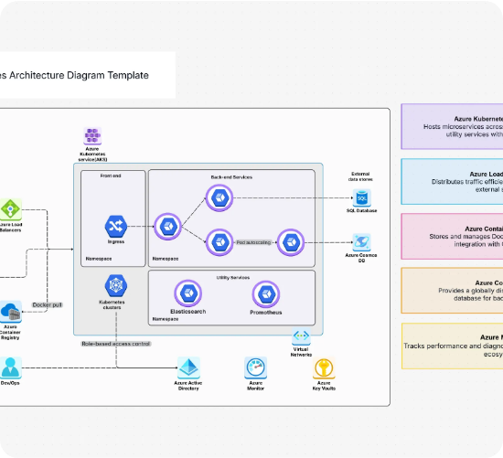
Cloud-Native Architecture
Zero-PII Engine: Isolated ML cluster processes tokenized IDs only.
Sub-200ms Latency: Real-time scoring using containerized FastAPI.
Immutable Auditing: Every prediction is logged for compliance.
Scalable Microservices: Deployed via Docker for elastic demand.

Slide 9
Risk Guardrails & Governance
Hard Floor ($2,000): Minimum safety limit ensures product utility for all qualified earners.
Automation Ceiling ($18,000): Caps automated exposure to maintain risk appetite.
Outlier Exception ($25k+): High-income earners are automatically routed for senior human review.
Monthly Drift Monitoring: Automated alerts if mathematical constants diverge from market trends.

Slide 10
90-Day Rollout Plan
Days 1-30
Days 31-60
Days 61-80
Day 90+
Shadow Mode: Compare model outputs vs human decisions without affecting live customers.
Pilot Phase: Enable automation for mid-tier income applicants with active guardrails.
Full Integration: Complete LOS handshake and real-time decisioning rollout.
Optimization: Post-release audit and revenue performance review.

Slide 11
Executive KPI Impact
Metric | Legacy (Manual) | Automated (ML) | Improvement
Wait Time | 24 - 48 Hours | < 1 Second | -99.9%
Decision Consistency | Subjective / Bias-prone | Mathematical / Auditable | Absolute
Onboarding Fall-off | 18% Abandonment | Projected < 6% | -66%
Ops Handling per App | $45.00 | $0.12 | -99%

Slide 12

Future Scalability
This Linear Regression engine is just the foundation. The same architecture will be scaled to Mortgage Prequalification, Dynamic Marketing Spend Optimization, and Personalized Interest Rate Modeling in Q1 2027.

Slide 13

Questions & Next Steps
Requested: Final Sign-off for Phase 1 (Shadow Mode)
Primary Contact: Lead Data Scientist / ML Expert
Department: Retail Risk & AI Center of Excellence

Slide 14




Image Sources
https://assets.qlik.com/image/upload/w_2378/q_auto/qlik/glossary/dashboard-examples/seo-hero-financial-dashboards_ttulhs.png
Source: www.qlik.com
https://cdn.cloudairy.com/template/1762767383847Q16%20(1).webp
Source: cloudairy.com
https://images.adsttc.com/media/images/6786/d72c/f6ca/3e01/88ac/1f82/newsletter/ziraat-bank-headquarters-kpf_1.jpg?1736890226
Source: www.archdaily.com
https://miro.medium.com/1*h8n1DG3IuNDPQ9nxWXNAaw.png
Source: medium.com

